Slide 1
CHAPTER 2(1)
Describing Syntax and Semantics

Slide 2
TOPICS
Introduction
The General Problem of Describing Syntax
Formal Methods of Describing Syntax
Attribute Grammars
Describing the Meanings of Programs: Dynamic Semantics
CCSB314 Programming Language
3-<number>

Slide 3
INTRODUCTION
Syntax: the form or structure of the expressions, statements, and program units
Semantics: the meaning of the expressions, statements, and program units
Eg.
  if (condition)
  statement1
  else
  statement 2
CCSB314 Programming Language
1-<number>

Slide 4
THE GENERAL PROBLEM OF DESCRIBING SYNTAX: TERMINOLOGY
A sentence is a string of characters over some alphabet
A language is a set of sentences
A lexeme is the lowest level syntactic unit of a language, including
  Numeric literals
  Operators
  Special words
A token is a category of lexemes, such as
  Identifier
  Arithmetic plus operator et cetera.
CCSB314 Programming Language
1-<number>

Slide 5
THE GENERAL PROBLEM OF DESCRIBING SYNTAX: TERMINOLOGY
Consider the following statement:
  index = 2 * count + 17;
  Lexemes Token
  index identifier
  = equal_sign
  2 int_literal
  * mult_op
  count identifier
  + plus_op
  17 int_literal
  ; semicolon
CCSB314 Programming Language
1-<number>

Slide 6
THE GENERAL PROBLEM OF DESCRIBING SYNTAX: TERMINOLOGY
2 distinct ways of defining a language:
  Language recognizers
    A recognition device reads input strings of the language and decides whether the input strings belong to the language
    R(∑)= L?
    Example: syntax analysis part of a compiler
  Language generators
    A device that generates sentences of a language
    One can determine if the syntax of a particular sentence is correct by comparing it to the structure of the generator
CCSB314 Programming Language
1-<number>

Slide 7
FORMAL METHODS OF DESCRIBING SYNTAX
Context-Free Grammars (CFG)
Backus-Naur Form (BNF) and
Extended BNF
CCSB314 Programming Language
1-<number>

Slide 8
FORMAL METHODS OF DESCRIBING SYNTAX: CFG
Context-Free Grammars
  Developed by Noam Chomsky, a noted linguist, in the mid-1950s
  Two of the four generative devices (grammars), meant to describe the four classes of (natural) languages are found to be useful for describing the syntax of programming languages.
  These are
    Context-free grammars: describe the syntax of whole programming languages
    Regular grammars: describe the forms of the tokens of programming languages
CCSB314 Programming Language
1-<number>

Slide 9
FORMAL METHODS OF DESCRIBING SYNTAX: BNF
Backus-Naur Form
  A formal notation for specifying programming language syntax initially presented by John Backus to describe ALGOL 58 in 1959.
  It was later modified slightly by Peter Naur to describe ALGOL 60, hence the Backus-Naur Form (BNF).
  Most popular method for concisely describing programming language syntax
CCSB314 Programming Language
1-<number>

Slide 10
FORMAL METHODS OF DESCRIBING SYNTAX: BNF
BNF is a metalanguage for programming languages
It uses abstractions to represent classes of syntactic structures
An abstraction of a JAVA assignment statement:
<assign> → <var> = <expression>
CSEB314 Programming Languages
A rule
The left-hand side (LHS) i.e. the abstraction being defined
The right-hand side (RHS) i.e. the definition of the LHS
3-<number>

Slide 11
FORMAL METHODS OF DESCRIBING SYNTAX: BNF
A possible instantiation of the previous rule is:
total = subtotal1 + subtotal2
The RHS, i.e. the definition can be a mixture of
  tokens
  lexemes and
  references to other abstractions
CCSB314 Programming Language
1-<number>

Slide 12
FORMAL METHODS OF DESCRIBING SYNTAX: BNF
BNF abstractions are often called the non-terminal symbols or in short the nonterminals.
Likewise, the lexemes and tokens are called the terminal symbols or the terminals.
BNF grammar is therefore a collection of rules.
CSEB314 Programming Languages
3-<number>

Slide 13
FORMAL METHODS OF DESCRIBING SYNTAX: BNF
Nonterminals can have two or more distinct definitons.
Consider another example of BNF rules:
  <if_stmt> → if (<logic_expr>) <stmt>
  <if_stmt> → if (<logic_expr>) <stmt> else <stmt>
which, can also be written as a single rule separated by the | symbol to mean logical OR.
  <if_stmt> → if (<logic_expr>) <stmt>
  | if (<logic_expr>) <stmt> else <stmt>
CCSB314 Programming Language
1-<number>

Slide 14
FORMAL METHODS OF DESCRIBING SYNTAX: BNF
BNF uses recursion to describe lists of syntactic elements in programming languages.
A rule is recursive if its LHS appears in its RHS. For example:
<ident_list> → identifier
| identifier, <ident_list>
CCSB314 Programming Language
1-<number>

Slide 15
FORMAL METHODS OF DESCRIBING SYNTAX: BNF
Derivation is a process of generating sentences through repeated application of rules, starting with the start symbol.
Consider the following BNF grammar:
<program> → begin <stmt_list> end
<stmt_list> → <stmt>
| <stmt>; <stmt_list>
<stmt> → <var> = <expression>
<var> → A | B | C
<expression> → <var> + <var>
| <var> - <var>
| <var>
CCSB314 Programming Language
1-<number>

Slide 16
FORMAL METHODS OF DESCRIBING SYNTAX: BNF
A derivation of the previous grammar is:
<program> => begin <stmt_list> end
=> begin <stmt>; <stmt_list> end
=> begin <var> = <expression>; <stmt_list> end
=> begin A = <expression>; <stmt_list> end
=> begin A = <var> + <var>; <stmt_list> end
=> begin A = B + <var>; <stmt_list> end
=> begin A = B + C; <stmt_list> end
=> begin A = B + C; <stmt> end
=> begin A = B + C; <var> = <expression> end
=> begin A = B + C; B = <expression> end
=> begin A = B + C; B = <var> end
=> begin A = B + C; B = C end
CSEB314 Programming Languages
3-<number>

Slide 17
FORMAL METHODS OF DESCRIBING SYNTAX: BNF
Every string in the derivation is called a sentential form
A sentence is a sentential form that has only terminal symbols
Previous derivation is called leftmost derivation, where the leftmost nonterminal in each sentential form is expanded.
A rightmost derivation is also possible, neither leftmost nor rightmost derivation is also possible.
It is not possible to exhaustively generate all possible sentences in finite time.
CCSB314 Programming Language
1-<number>

Slide 18
FORMAL METHODS OF DESCRIBING SYNTAX: BNF
Exercise: Create a derivation from this grammar
<assign> → <id> = <expr>
<id> → A | B | C
<expr> → <id> + <expr>
|<id> * <expr>
| ( <expr> )
|<id>
CCSB314 Programming Language
1-<number>

Slide 19
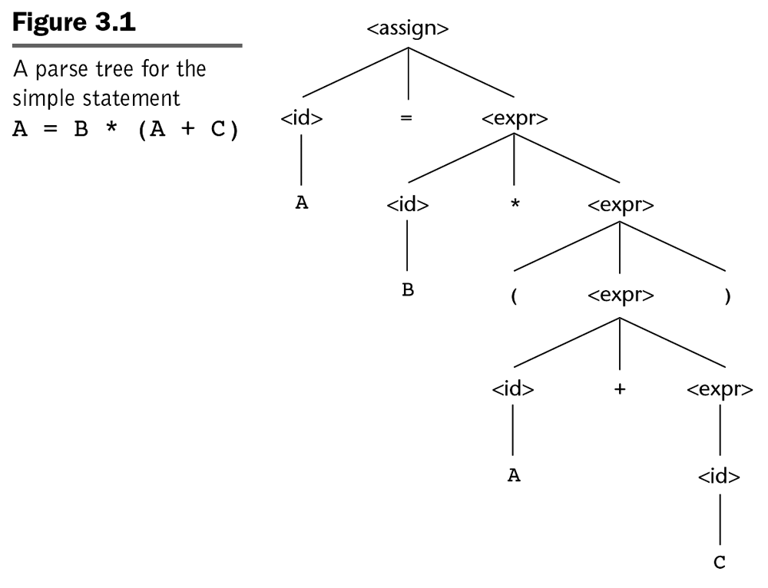
FORMAL METHODS OF DESCRIBING SYNTAX: BNF
Parse tree is a hierarchical syntactic structure of a derived sentence.
CCSB314 Programming Language
1-<number>

Slide 20
FORMAL METHODS OF DESCRIBING SYNTAX: BNF
Every internal node of a parse tree is labeled with a nonterminal symbol.
Every leaf is labeled with a terminal symbol.
Every subtree of a parse tree describes one instance of an abstraction in the sentence.
CCSB314 Programming Language
1-<number>

Slide 21
FORMAL METHODS OF DESCRIBING SYNTAX: BNF
A grammar is ambiguous if it generates a sentential form that has two or more distinct parse trees.
Consider the following BNF grammar:
<assign> → <id> = <expr>
<id> → A | B | C
<expr> → <expr> + <expr>
| <expr> * <expr>
| ( <expr> )
|<id>
CCSB314 Programming Language
1-<number>

Slide 22
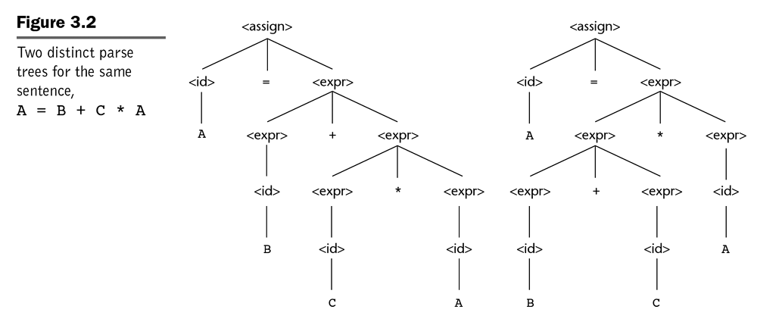
FORMAL METHODS OF DESCRIBING SYNTAX: BNF
CCSB314 Programming Language
1-<number>

Slide 23
FORMAL METHODS OF DESCRIBING SYNTAX: BNF
Solutions to ambiguity:
  Operator precedence
    Assigning different precedence levels to operators
  Associativity of operators
    Specifies ‘precedence’ of two operators that have the same precedence level.
CSEB314 Programming Languages
3-<number>

Slide 24
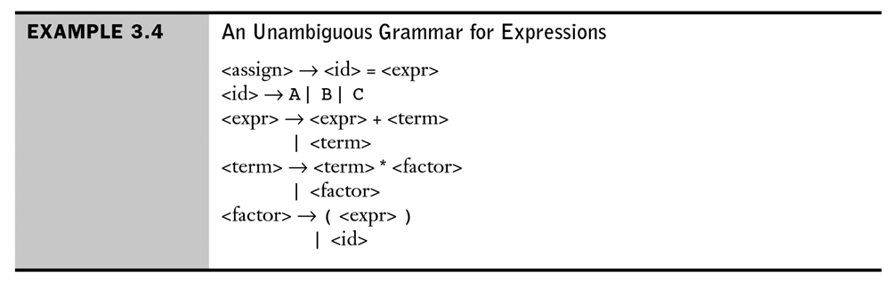
FORMAL METHODS OF DESCRIBING SYNTAX: BNF
An example of an unambiguous grammar that defines operator precedence:
CCSB314 Programming Language
1-<number>

Slide 25
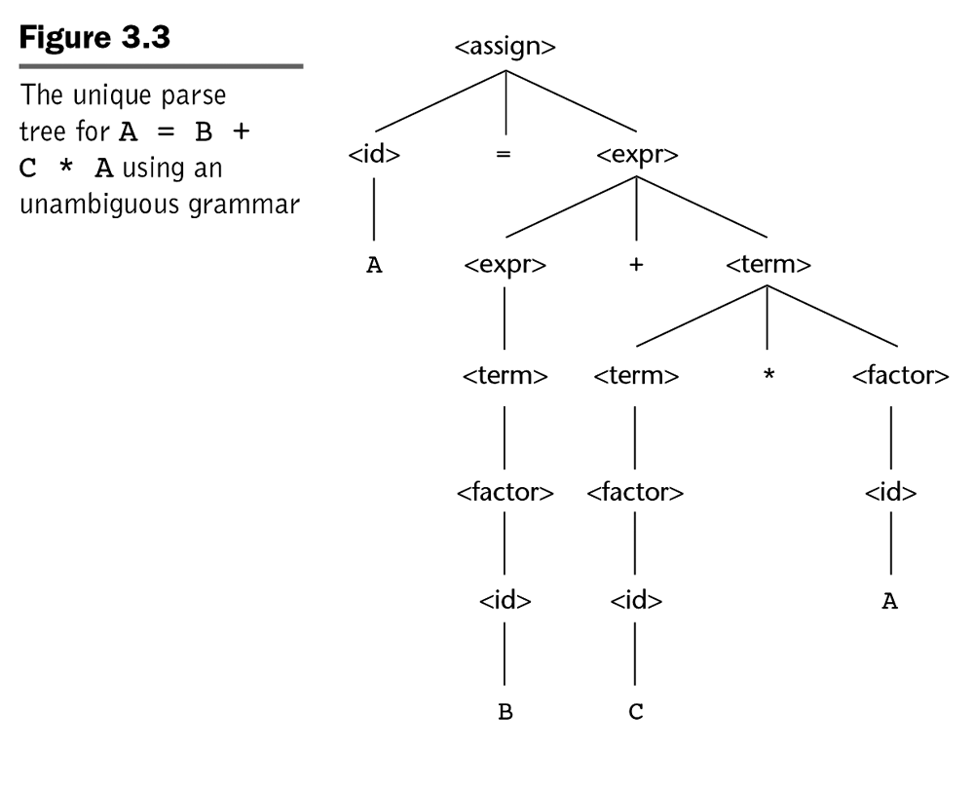
FORMAL METHODS OF DESCRIBING SYNTAX: BNF
CCSB314 Programming Language
1-<number>

Slide 26
FORMAL METHODS OF DESCRIBING SYNTAX: BNF
A rule is said to be left recursive if its LHS is also appearing at the beginning of its RHS.
Likewise, a grammar rule is right recursive if the LHS appears at the right end of the RHS.
<factor> → <exp> ** <factor>
| <exp>
<exp> → ( <expr> )
| id
CCSB314 Programming Language
1-<number>

Slide 27
FORMAL METHODS OF DESCRIBING SYNTAX: EXTENDED BNF
  Improves readability and writability of BNF
Three common extensions are:
  Optional parts of an RHS, delimited by square brackets. E.g.
  EBNF Format
  <if_stmt> → if (<logic_expr>) <stmt> [else<stmt>]
  BNF Format
  <if_stmt> → if (<logic_expr>) <stmt>
  | if (<logic_expr>) <stmt> else <stmt>
CCSB314 Programming Language
1-<number>

Slide 28
FORMAL METHODS OF DESCRIBING SYNTAX: EXTENDED BNF
  The use of curly braces in an RHS to indicate that the enclosed part can be repeated indefinitely or left out altogether.
  EBNF Format
<ident_list> → <identifier> {, <identifier>}
  BNF Format
<ident_list> → identifier
| identifier, <ident_list>
CCSB314 Programming Language
1-<number>

Slide 29
FORMAL METHODS OF DESCRIBING SYNTAX: EXTENDED BNF
  For multiple choice options, the options are placed inside parentheses and separated by the OR operator.
  EBNF Format
<term> → <term> (*|/|%) <factor>
  BNF Format
<term> → <term> * <factor>
| <term> / <factor>
| <term> % <factor>
CCSB314 Programming Language
1-<number>

Slide 30
FORMAL METHODS OF DESCRIBING SYNTAX: EXTENDED BNF
BNF
<expr> → <expr> + <term>
| <expr> - <term>
| <term>
<term> → <term> * <factor>
| <term> / <factor>
| <factor>
<factor> → <exp> ** <factor>
| <exp>
<exp> → ( <expr> )
| id
CCSB314 Programming Language
1-<number>

Slide 31
FORMAL METHODS OF DESCRIBING SYNTAX: EXTENDED BNF
EBNF
<expr> → <term> {(+ | -) <term>}
<term> → <factor> {(* | /) <factor>}
<factor> → <exp> {** <exp>}
<exp> → ( <expr> )
| id
CSEB314 Programming Languages
3-<number>

Slide 32
FORMAL METHODS OF DESCRIBING SYNTAX: EXTENDED BNF
Other variations of EBNF:
  Numeric superscript attached to the right curly brace to indicate repetition upper limit.
  A plus (+) superscript to indicate one or more repetition.
  A colon used in place of the arrow and the RHS is moved to the next line.
  Alternative RHSs are separated by new line rather than vertical bar.
  Subscript opt is used to indicate something being optional rather than square brackets.
  Et cetera …
CSEB314 Programming Languages
3-<number>

Slide 33
ATTRIBUTE GRAMMARS
An extension to CFG that allows some characteristics of the structure of programming languages that are either difficult or impossible to be described using BNF.
  Difficult e.g. type compatibility
  Impossible e.g. all variable must be declared before they are referenced.
Therefore, the need for static semantic rules e.g. attribute grammars.
The additions are:
  attributes
  attribute computation functions
  predicate functions
CCSB314 Programming Language
1-<number>

Slide 34
ATTRIBUTE GRAMMARS: DEFINITION
Associated with each grammar symbol X is a set of attributes A(X).
The set A(X) consists of two disjoint sets,
  S(X), synthesised attributes, used to pass semantic information up a parse tree and
  I(X), inherited attributes, used to pass semantic information down and across a tree.
CCSB314 Programming Language
1-<number>

Slide 35
ATTRIBUTE GRAMMARS: DEFINITION
Associated with each grammar rule is a set of semantic functions and a possibly empty set of predicate functions over the attributes of the symbols in the grammar rule.
  For a rule X₀ → X₁ ... X_{n}, the synthesised attributes of X₀ are computed with semantic functions of the form:
S(X₀) = f(A(X₁), ... , A(X_{n}))
  Likewise, inherited attributes of symbols X_{j}, 1 ≤ j ≤ n are computed with a semantic function of the form:
I(X_{j}) = f(A(X₀), ... , A(X_{n}))
CSEB314 Programming Languages
3-<number>

Slide 36
ATTRIBUTE GRAMMARS: DEFINITION
A predicate function has the form of a Boolean expression on the union of the attribute set {A(X₀), …, A(X_{n})}
  The only derivations allowed with an attribute grammar are those in which every predicate associated with every nonterminal is true.
Intrinsic attributes are synthesised attributes of leaf nodes whose values are determined outside the parse tree
CCSB314 Programming Language
1-<number>

Slide 37
ATTRIBUTE GRAMMARS: EXAMPLE
Syntax rule:
  <proc_def> → procedure <proc_name>[1] <proc_body> end <proc_name>[2];
Predicate:
<proc_name>[1].string == <proc_name>[2].string
I.e. the predicate rule states that the name string attribute of the <proc_name> nonterminal in the subprogram header must match the name string attribute of the <proc_name> nonterminal following the end of the subprogram.
CCSB314 Programming Language
1-<number>

Slide 38
ATTRIBUTE GRAMMARS: EXAMPLE
Consider the following grammar
<assign> → <var> = <expr>
<expr> → <var> + <var>
| <var>
<var> → A | B | C
CSEB314 Programming Languages
3-<number>

Slide 39
ATTRIBUTE GRAMMARS: EXAMPLE
And the following requirements …
  The variables can be one of two types, int or real
  When there are two variables on the right side of an assignment, they need not be the same type
  The type of the expression when the operand types are not the same is always real
  When they are the same, the expression type is that of the operands.
  The type of the left side of the assignment must match the type of the right side
  So, the types of operands in the right side can be mixed, but the assignment is valid only if the target and the value resulting from evaluating the right side have the same type.
CSEB314 Programming Languages
3-<number>

Slide 40
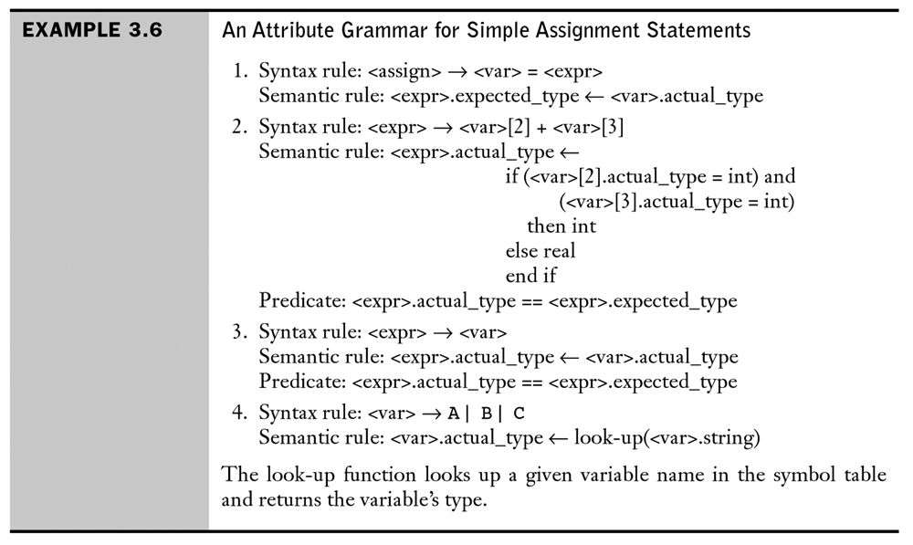
ATTRIBUTE GRAMMARS: EXAMPLE
CCSB314 Programming Language
1-<number>

Slide 41
ATTRIBUTE GRAMMARS: EXAMPLE
<assign>
<expr>
CCSB314 Programming Language
<var>
<var>[2]
<var>[3]
A
=
A
+
B
1-<number>

Slide 42
ATTRIBUTE GRAMMARS: COMPUTING ATTRIBUTE VALUES
If all attributes were inherited, the tree could be decorated in top-down order.
If all attributes were synthesized, the tree could be decorated in bottom-up order.
In many cases, both kinds of attributes are used, and it is some combination of top-down and bottom-up orders. E.g.:
  <var>.actual_type ← look-up(A) (Rule 4)
  <expr>.expected_type ← <var>.actual_type (Rule 1)
  <var>[2].actual_type ← look-up(A) (Rule 4)
  <var>[3].actual_type ← look-up(B) (Rule 4)
  <expr>.actual_type ← either int or real (Rule 2)
  <expr>.expected_type == <expr>.actual_type is either TRUE or FALSE (Rule 2)
CCSB314 Programming Language
1-<number>

Slide 43
ATTRIBUTE GRAMMARS: COMPUTING ATTRIBUTE VALUES
<assign>
expected_type
<expr>
actual_type
CCSB314 Programming Language
<var>
actual_type
<var>[2]
actual_type
<var>[3]
actual_type
A
=
A
+
B
1-<number>

Slide 44
ATTRIBUTE GRAMMARS: COMPUTING ATTRIBUTE VALUES
<assign>
expected_type
<expr>
actual_type
expected_type=real_type
actual_type= real_type
CCSB314 Programming Language
actual_type= real_type
<var>
actual_type= real_type
<var>[2]
actual_type
<var>[3]
actual_type
actual_type= int_type
A
=
A
+
B
1-<number>

